Slide 1
TrendMiner Success Series - Admin Track May 6th, 2026 TrendMiner Indexing: From Understanding to Optimization
Welcome to the webinar. We will start momentarily.

Slide 2



Listen only mode
Use the question area
in the side panel Q&A at the end
A recording + slides will be made available after the webinar
Notes:
00:20

Slide 3
In today’s session
Intro
Recap on indexing basics
Index policies
Index update frequency based on usage
Indexing flow
End-to-end overview of different components
Data source performance
Align index settings in TrendMiner with your data source performance
Tips and tricks
How to do a health check on your installation
Closing and Questions
Wrap up
Notes:
1:00

Slide 4
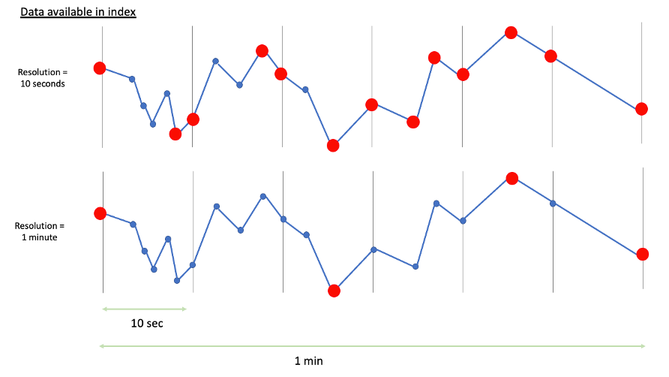
What is indexing?
“Cache” of the raw data​
Goal: speed up analysis
​
Index resolution: level of detail TrendMiner requests from the data source
Notes:
2:00

Slide 5
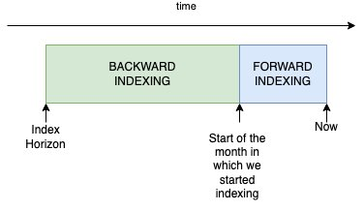
Backward/forward indexing
Backward ​start of current month -> index horizon
Forward​ 2 types:​
Continuous: triggered based on index policy​
Interactive: manually triggered when added to the chart or when loaded in a trend tile in DashHub
Index horizon = date until which TrendMiner indexes data.​
Notes:
4:00

Slide 6
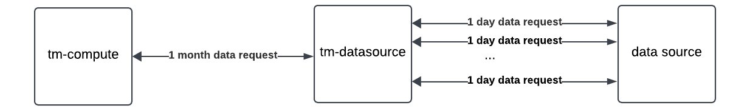
Index granularity
Sets time period for data request by tm-datasource (default = 1M)​
Avoid overload on historian and request timeouts
Notes:
4:40

Slide 7






Index statuses
Healthy index.
Backward indexing.
Issue with forward index calls. Could be temporary issue. Investigate if it persists.
Backward indexing could not be completed because of error. No impact on recent data or monitors. Investigate if needed.
Tag stopped indexing because tag or data source got deleted. Could be expected behavior.
Tag stopped indexing because it has no data for > 1 year. Could be expected behavior.
Avoid “out of date” or “incomplete” tag
Or make sure you understand why they are failing
Notes:
7:00

Slide 8
Index policies (update cycles)
Every 2 minutes:
Tags from active monitors
Every hour
Default indexing policy for used tags
Every day
Reduced indexing policy for tags not used for 1 week
Never
Policy for dormant tags = tags without data for 1 year
Notes:
8:00

Slide 9
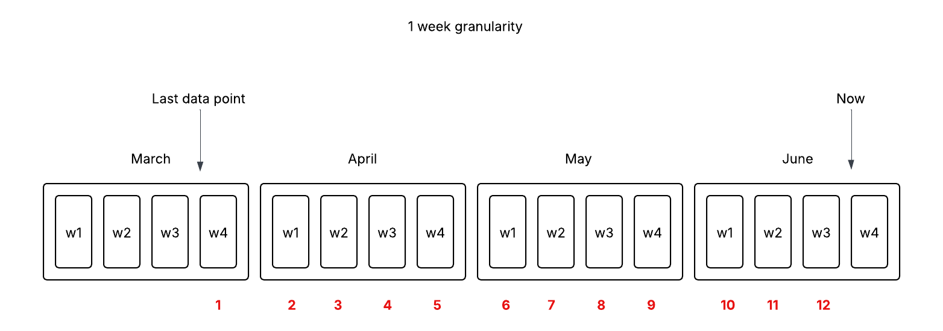
Dormant tags
Example 1
1 week granularity
No data for 12 weeks
10 tags with default 1 hour policy
100ms response time
Result: 1 week x 12 weeks x 10 tags x 100ms/call = 120 calls/hour x 100ms/call = 12s per hour wasted.
Example 2
1 day granularity
No data for 1 year (365 days)
10 tags with 2 minute policy (30 calls/hour/tag)
200ms per response time
Result: 1 day/call x 365 days x 30 calls/hour/tag x 10 tags x 200ms/tag ~ 110k calls/hour x 200ms/call = ~ 6h per hour wasted.
Notes:
10:00

Slide 10
Dormant tags
Important!
Re-indexing sets last data point to current month => 1 year grace period to set back to dormant
The dormant state is ignored for monitored tags and TrendMiner will keep trying to update this tag every 2 minutes.
Before re-indexing
After re-indexing
Notes:
11:30

Slide 11
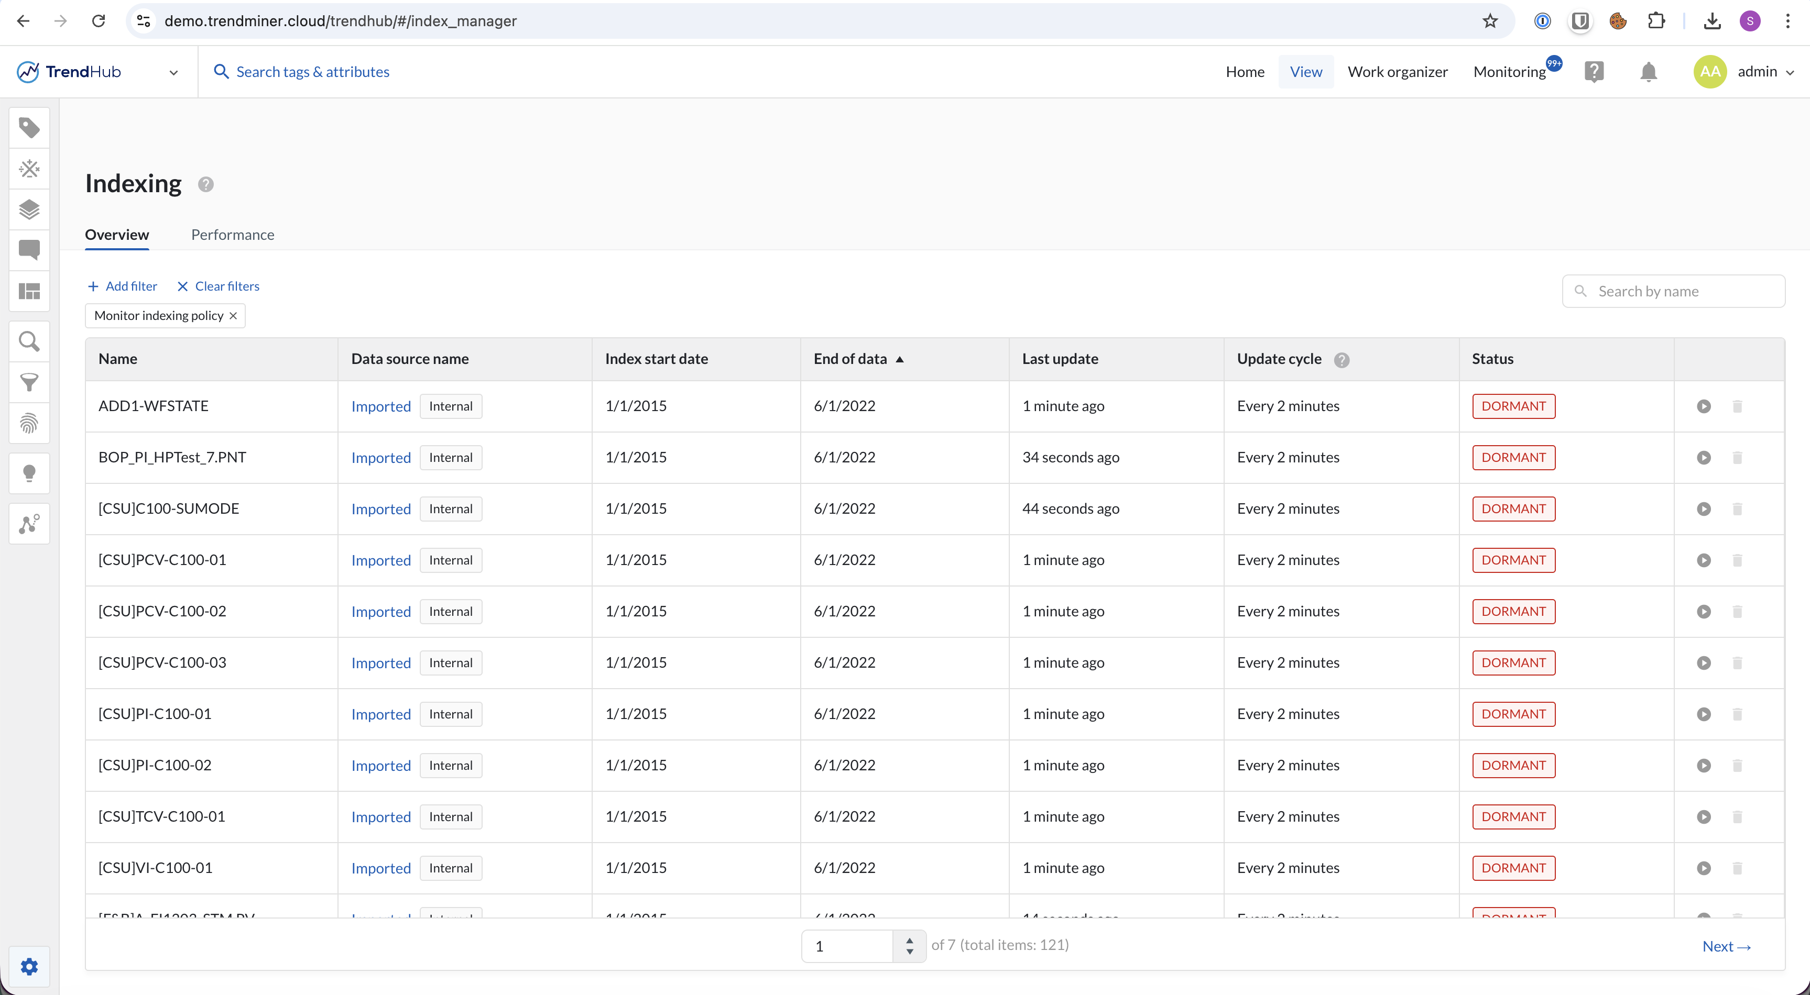
Takeaway
Disable monitors on ‘dormant’ tags filter on 2 min index policy and sort by “end of data”
Notes:
12:00

Slide 12
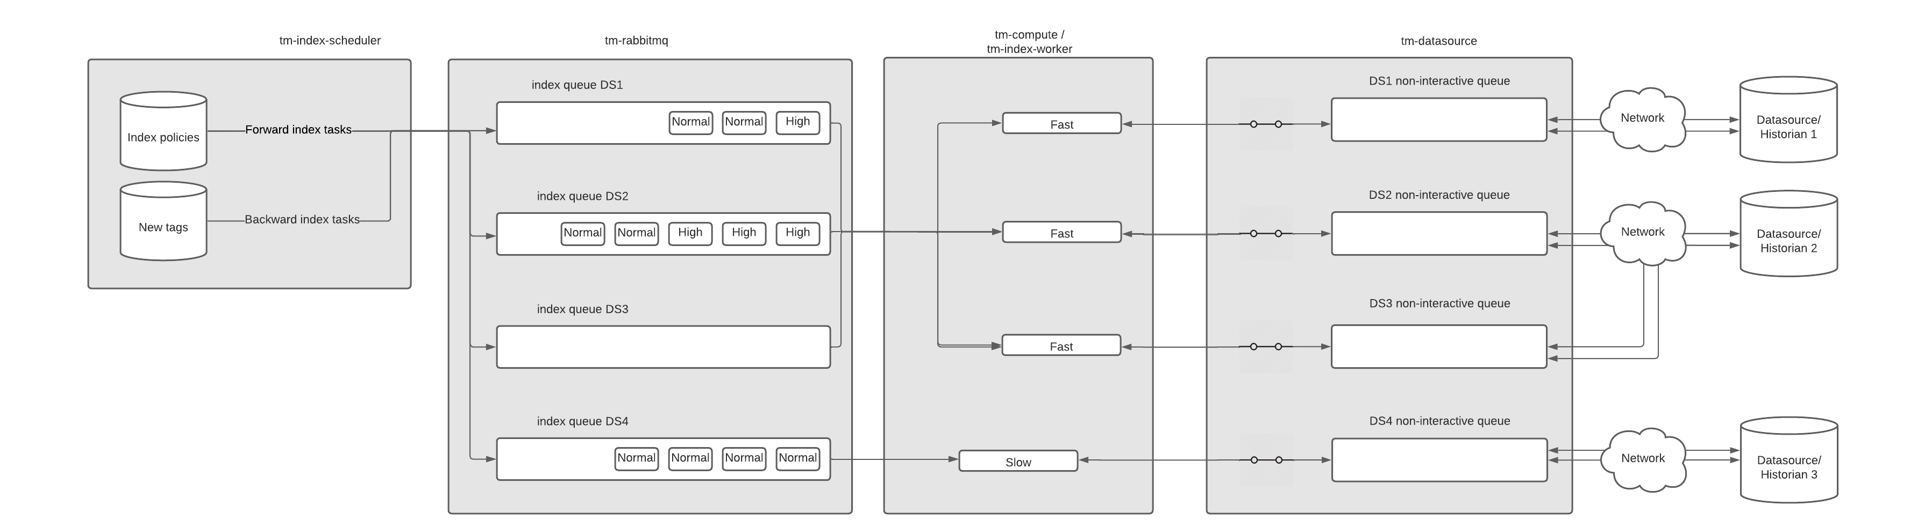
Indexing flow
Different services: tm-index-scheduler, tm-rabbitmq, tm-compute, tm-datasource
Different queues: tm-rabbitmq, tm-datasource
Different processing threads: tm-index-scheduler, tm-index-worker, tm-datasource
Different settings: simultaneous index operations, parallel connections
Notes:
13:00

Slide 13
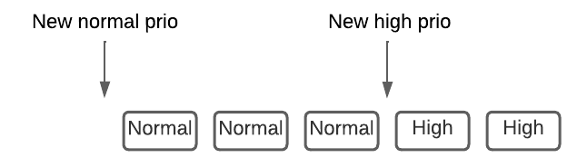
tm-index-scheduler
Tags with highest delay are prioritized for indexing (independent of the data source)
3 most recent months are added with high priority, others with normal prio
Max 1 backward indexing task (“in progress”) per tag
Notes:
14:30

Slide 14
tm-rabbitmq
Each data source has its own queue -> no interference between data sources
Forward indexing = normal prio
Interactive forward indexing = high prio (live views and dashboards)
Backward indexing = normal prio with 1 hour timeout => high prio
Notes:
16:00

Slide 15
tm-rabbitmq
On a system with heavy load backward indexing will progress at a rate of 1 month per hour
Backward indexing can cause monitoring delays if backward index tasks time out after 1 hour, which implies:
Data source is slow
Too many backward indexing tasks are added at the same time
Likely a combination of both
Backward index calls can be slower (larger time frame + older data)
Notes:
17:40

Slide 16
tm-rabbitmq
Impact of backward indexing is limited, even on a congested system. E.g.
10 tags doing backward indexing = 10 index calls per hour
1 monitor on 1 tag = 30 index calls per hour
Backward indexing can cause bigger issues if done excessively and data source response times are long. E.g.
1800 tags with 2s response time = 1 hour/hour => monitor delays!
Do not (re-)index too many tags in parallel
Use batch index script with batch size <10
Notes:
19:00

Slide 17
tm-compute
All data sources are grouped into fast and slow.
Simultaneous index operations (=indexing threads) divided over fast and slow based on #tags
Notes:
19:50

Slide 18
Indexing threads vs. data source performance
Notes:
20:00

Slide 19
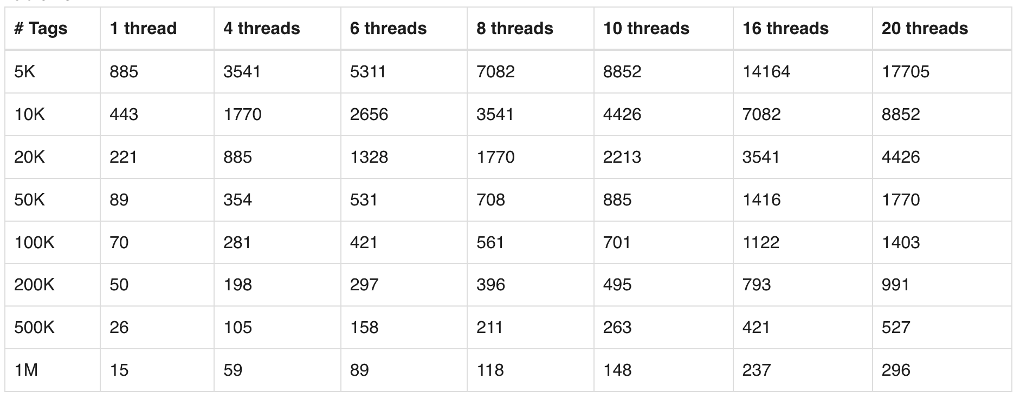
Indexing threads vs. data source performance
x = monitor policy (2 min = 720 updates per day)
y = default policy (1 hour = 24 updates per day)
z = reduced policy (1 day = 1 update per day)
p = indexing threads / simultaneous index operations
r = data source response time
x= 2% (with a max of 1000); y = 18%; z = 80%
Total time = ((720x + 24y + z) / p) × r
r_max = (86.400.000 × p) / (720x + 24y + z)
Notes:
22:00

Slide 20
Indexing threads vs. data source performance
Indexing threads:
Too high:
Limited by data source resources: data sources might be overloaded and become slower or unresponsive
Limited by TM system resources: 1 thread = 1 CPU + memory to store ingested data
Too low:
Less throughput, more risk on congestion
Notes:
23:00

Slide 21
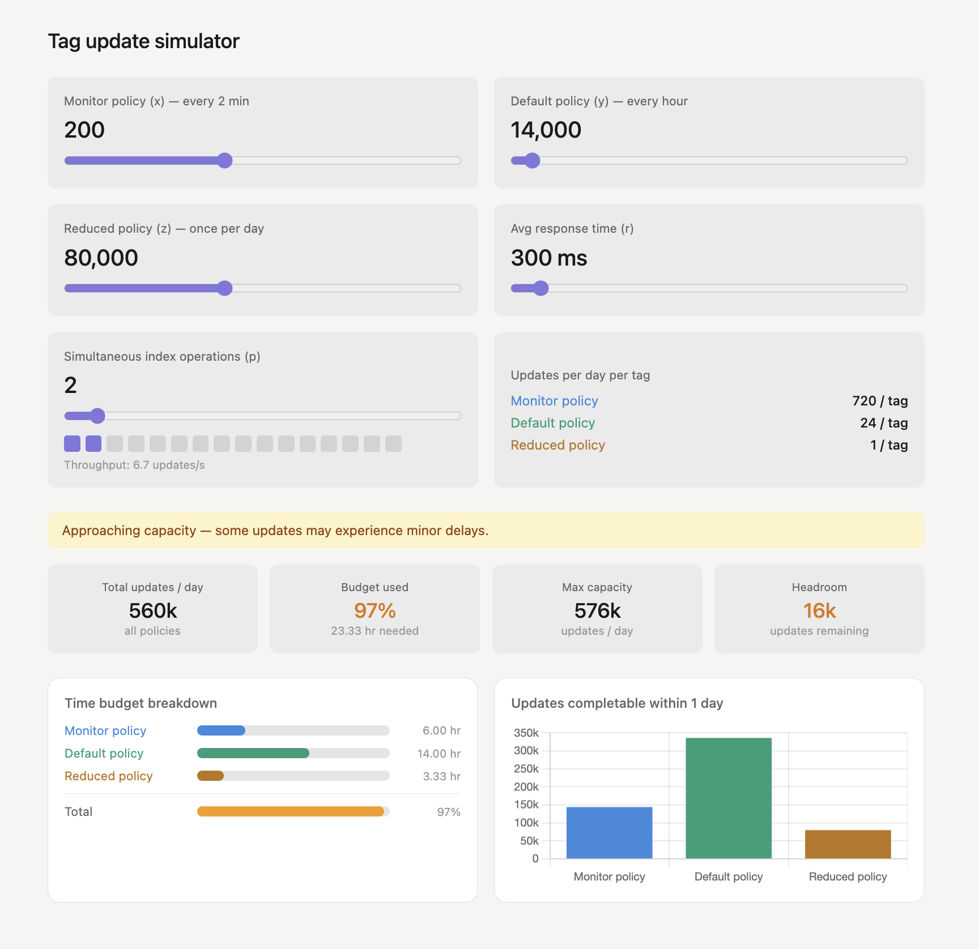
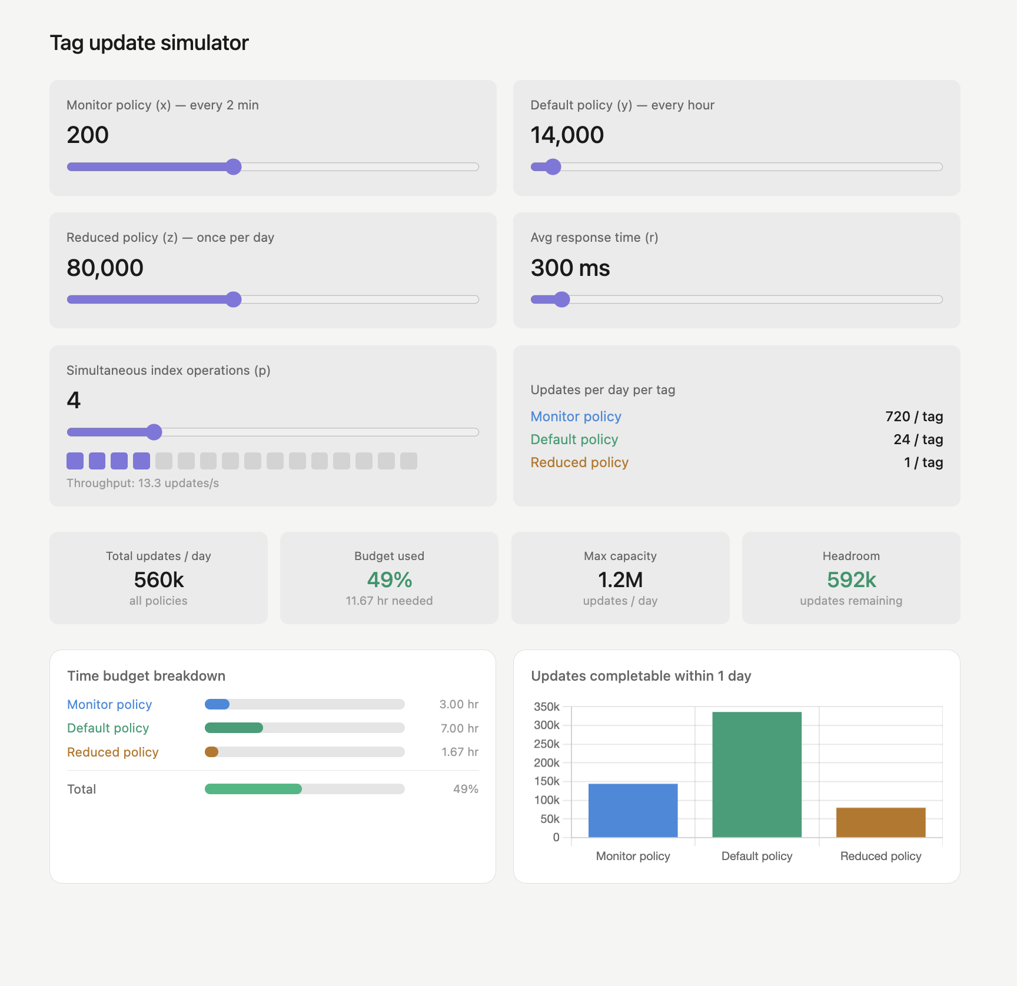
Indexing threads vs. data source performance
Notes:
23:30

Slide 22
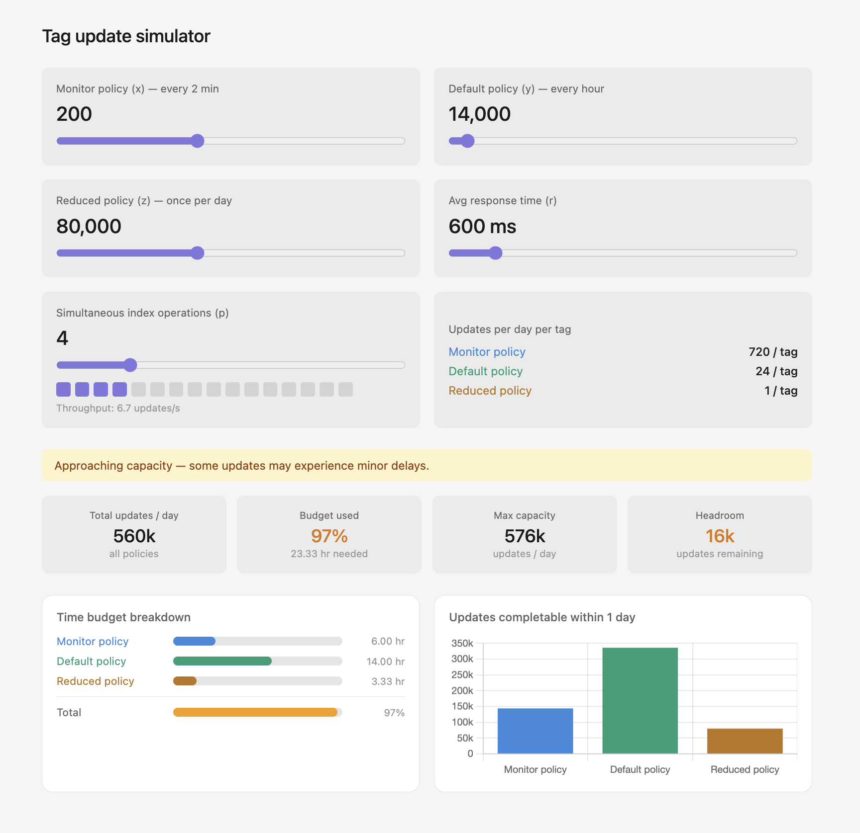
Indexing threads vs. data source performance
Notes:
23:40

Slide 23
Indexing threads vs. data source performance
Performance data sources | Advised action
All data sources perform well | Increase indexing threads
All data sources perform bad | Decrease indexing threads OR increase data source performance
Some data sources perform bad | Increase performance of underperforming data sources
Increase indexing threads only if your data sources can handle the load
Gradually increase and keep monitoring the response times
Notes:
24:20

Slide 24
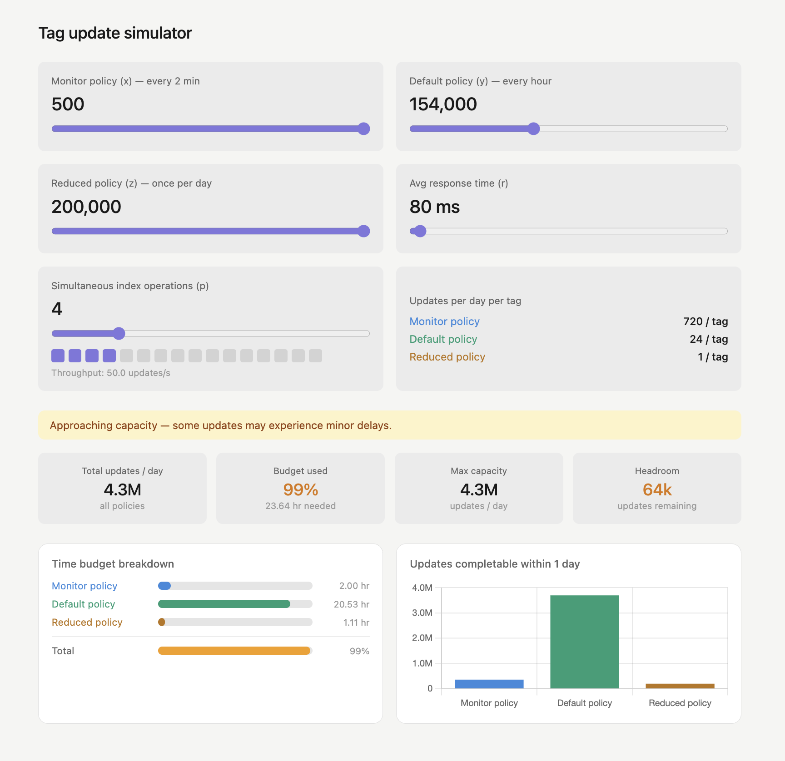
Indexing threads vs. data source performance
Notes:
25:00

Slide 25
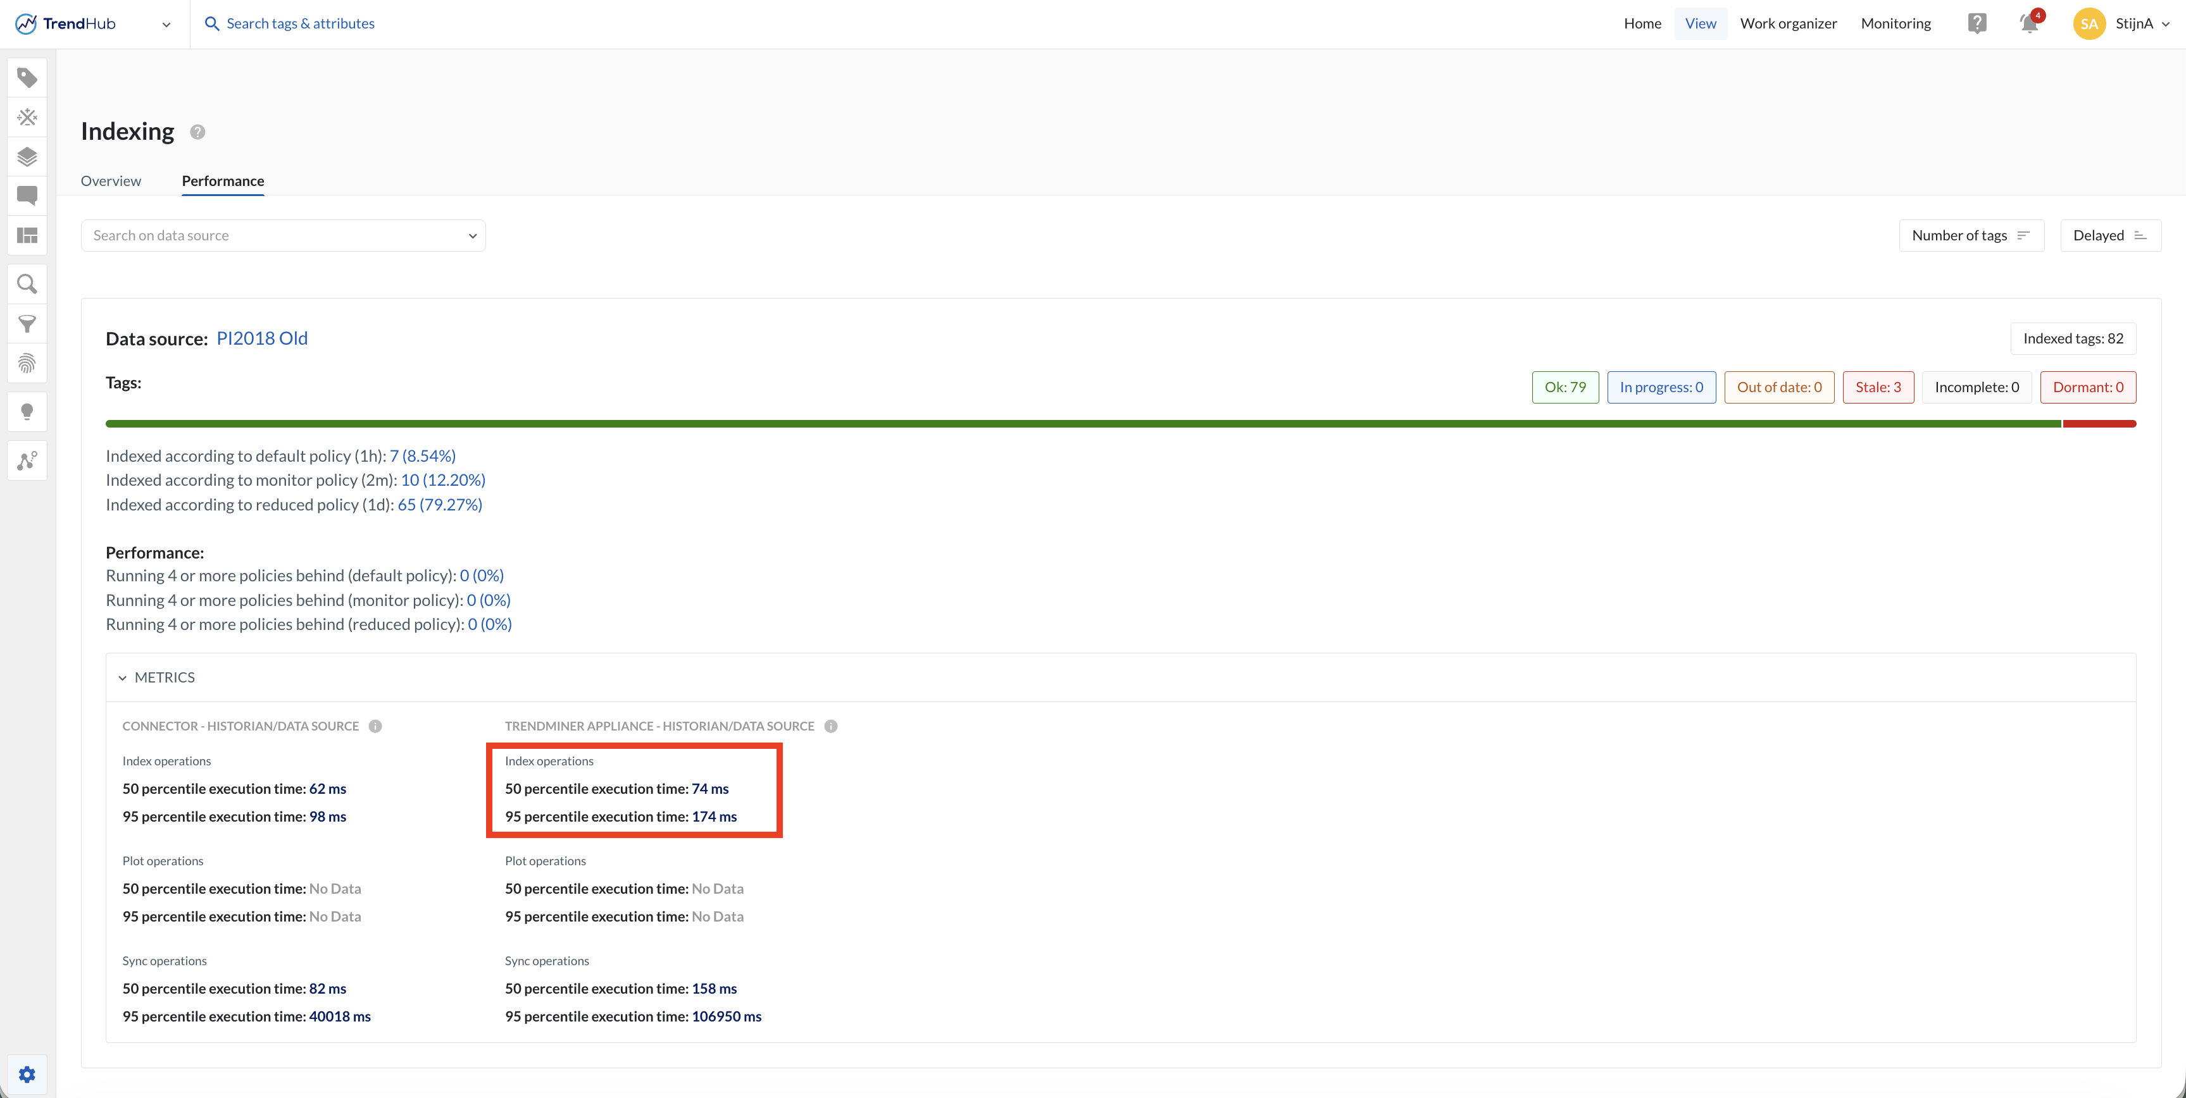
Good data source response time is crucial for performant indexing
Check the response times in the index manager in case of delays
Notes:
25:20

Slide 26
Disclaimer
Calculations and models are oversimplified! Not taken into account:
Data source parallel connections
Index granularity
Data sources typically have different response times
Response times can differ significantly depending on requested time period (size and recency)
System resources are shared with other services (context, assets,dashboards, …)
Interactive index calls (e.g. live dashboards)
Influence of temporary connection issues
Data source error responses inflict penalties
Indexing flow has hardcoded polling limits (max 100 index tasks per data source per 5s)
…
Notes:
28:00

Slide 27
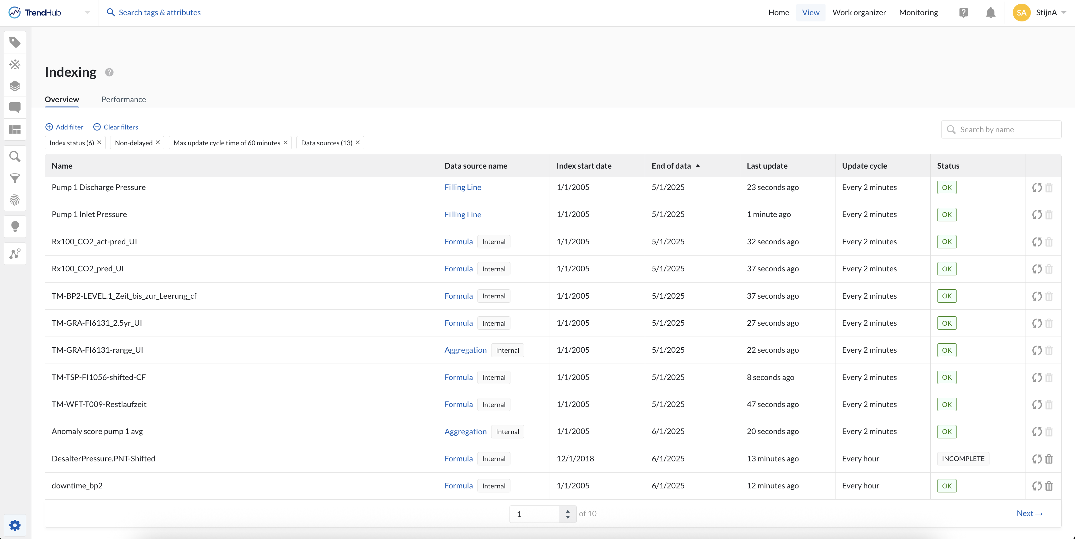
Sort by “End of data” ascending to see which tags do redundant calls and are candidates to become ‘dormant’.
Optimal case: End of data = close to “Last update” (for all tags)
Tips and tricks
This example will lead to suboptimal performance (if today = e.g. March 1st 2026)
Notes:
29:20

Slide 28
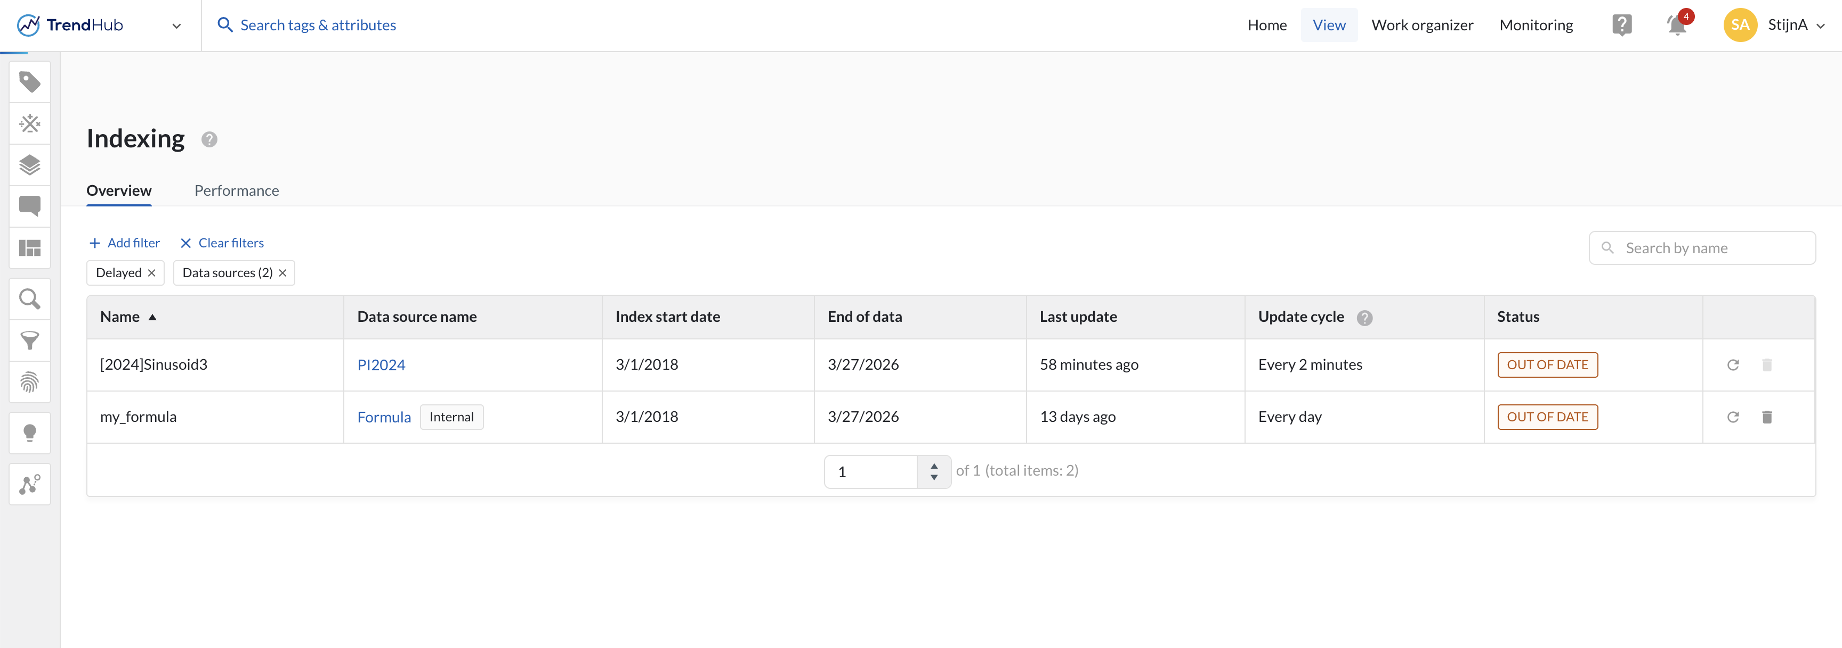
“Out of date” tags indicate errors for fetching data. For calculated tags, check the underlying data source tags
Tips and tricks
Check for delayed tags. If all tags are delayed the system might be congested.
Preferably no tags are delayed.
Notes:
30:30

Slide 29
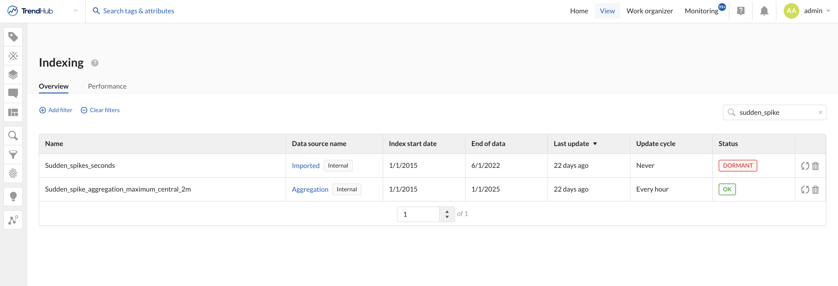
Tips and tricks
Status ‘OK’ does not mean the tag has recent data. It just indicates there is nothing wrong with the tag itself.
It can depend on a dormant tag for example.
Notes:
31:00

Slide 30
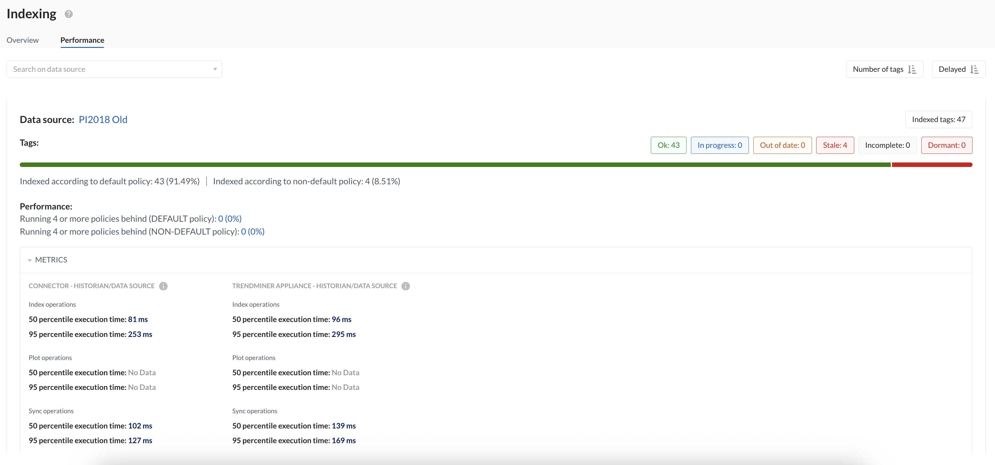
Tips and tricks
“CONNECTOR - HISTORIAN/DATA SOURCE” column not available for data sources which do not connect via a TM connector
Index operations = backward + forward indexing
The lower the better: <1s = ok; >10s = bad. But only user experience matters.
“No Data” = no calls in the last hour
Notes:
33:00

Slide 31
Pages referenced in this webinar
How to determine the best "simultaneous index operations" configuration? https://documentation.trendminer.com/en/how-to-determine-the-best--simultaneous-index-operations--configuration-.html
Index manager and performance overview https://documentation.trendminer.com/en/index-manager-and-performance-overview.html
Indexing explained https://userguide.trendminer.com/en/indexing-explained.html
How to evaluate time series data source metrics https://documentation.trendminer.com/en/how-to-evaluate-time-series-data-source-metrics.html
Tag index update simulator https://community.trendminer.com/p/tagupdate
Tip: ask your favorite AI chatbot to help out (but always verify against our docs)
Useful resources
Notes:
33:10

Slide 32
Save the dates
Next admin webinar
June 17th, 3:30pm CEST / 8:30am CDT
TrendLab EU
Eindhoven, September 23rd - 24th
TrendLab US
Houston, October 7th - 8th
Notes:
33:20

Slide 33
Questions?

Slide 34
Keep slide hidden
Internal Resources: see notes
Notes:
Icons: https://trendminercom.sharepoint.com/sites/TrendMiner-Marketing/Freigegebene%20Dokumente/Forms/AllItems.aspx?id=%2Fsites%2FTrendMiner%2DMarketing%2FFreigegebene%20Dokumente%2FGeneral%2F00%20Brandstyle%20and%20items%2F02%20Icons&p=true&ga=1

Slide 35

In 2026.R1 monitored tags can also become dormant?

